Slide 1

EMPLOYEE DATA ANALYSING USING TOOLS
STUDENT NAME: Mirra alfasa. v
REGISTER NUMBER: 312215918
DEPARTMENT: b.com accounting & finance
COLLEGE: shri shankarlal sundarbai shasun jain college for women

Slide 2
PROJECT TITLE
EMPLOYEE PERFORMANCE ANALYSIS USING EXCEL………

Slide 3
AGENDA
1.Problem Statement
2.Project Overview
3.End Users
4.Our Solution and Proposition
5.Dataset Description
6.Modelling Approach
7. Results and Discussion
8.Conclusion

Slide 4
PROBLEM STATEMENT
1. Clean and preprocess employee data
2. Generate descriptive statistics and summaries
3. Create interactive and dynamic visualizations
4. Identify trends, correlations, and areas for improvement
5. Develop predictive models to inform talent management strategies

Slide 5
PROBLEM STATEMENT
What are the demographic characteristics of our employee base?
How do performance metrics vary by department, role, or tenure?
What factors contribute to employee turnover, and how can we improve retention?
Are there any correlations between employee engagement and performance outcomes?
Can we predict employee churn using historical data and machine learning techniques?

Slide 6
PROJECT OVERVIEW
Objective:-
To design and develop an Excel-based dashboard for analyzing and visualizing employee data
To provide insights and recommendations for improving employee engagement, retention, and performance
To enable data-driven decision-making for HR and talent management strategies
Scope:-
Collect and preprocess employee data from various sources (e.g., HRIS, surveys, performance reviews)
Develop a comprehensive Excel dashboard with interactive visualizations and summaries
Analyze and interpret key metrics and trends, including: - Demographics and diversity - Performance and productivity - Engagement and satisfaction - Retention and turnover - Training and development
Identify areas for improvement and provide data-driven recommendations- Present findings and insights to stakeholders through clear and concise reporting

Slide 7
WHO ARE THE END USERS:-
The end users of the Employee Data Analysis using Excel are:
1. HR Leadership: CHRO, HR Directors, and HR Managers who need insights to inform talent management strategies and make data-driven decisions.
2. Talent Management and Development Teams: Teams responsible for employee training, development, and performance management, who can use data to identify skill gaps and create targeted programs.
3. Business Leaders and Decision-Makers: CEOs, CFOs, and Department Heads who need to understand the impact of HR initiatives on business outcomes and make strategic decisions.
4. HR Analysts and Specialists: HR professionals who will maintain and update the Excel dashboard, perform ad-hoc analysis, and provide insights to stakeholders.
5. Employee Managers and Supervisors: Line managers who can use data to understand their team's dynamics, identify areas for improvement, and make informed decisions about employee development and performance.
6. Compensation and Benefits Teams: Teams responsible for designing and administering compensation and benefits programs, who can use data to ensure equity and competitiveness.
7. Diversity, Equity, and Inclusion (DEI) Teams: Teams focused on promoting diversity, equity, and inclusion, who can use data to track progress and identify areas for improvement.

Slide 8
OUR SOLUTION AND ITS VALUE PROPOSITION
Key Benefits:
1. Data-Driven Decision Making: Make informed decisions about talent management, employee engagement, and retention.
2. Improved Employee Experience: Identify areas for improvement and create targeted initiatives to enhance employee satisfaction.
3. Enhanced Productivity: Optimize workforce planning, talent development, and performance management.
4. Cost Savings: Reduce turnover costs, improve resource allocation, and optimize HR initiatives.
5. Competitive Advantage: Gain a deeper understanding of your workforce and make data-driven decisions to drive business success.

Slide 9
DATASET DESCRIPTION
Employee data set taken from the KAGGLE
In dataset, out of 26 data I took only 9 features out of it.
The selected 10 features are listed below:
1. Employee ID 6. Employee status
2. First name 7. Employee classification type
3. Last name 8. Gender code
4. Business unit 9. Performance code
5. Employee Type 10. Current employee rating

Slide 10
MODELLING
1) DATA COLLECTION
The data has been collected through Edunet dash board.
2) FEATURE COLLECTION
The listed 10 features were taken for the analyses of data
3) DATA CLEANING
Identifying the missing values.
Filtering of those missing values
4) CALCULATION OF PERFORMANCE LEVEL
By considering the current eroployee rating, I found the performance level using the formula.

Slide 11
MODELLING
4) SUMMARY OF PIVOT LEVEL
Segregating od certain features to rows, columns, heading and so on.
5) SIVISUALIZATION
Once completed with pivot table, created the graph for precise visualization

Slide 12
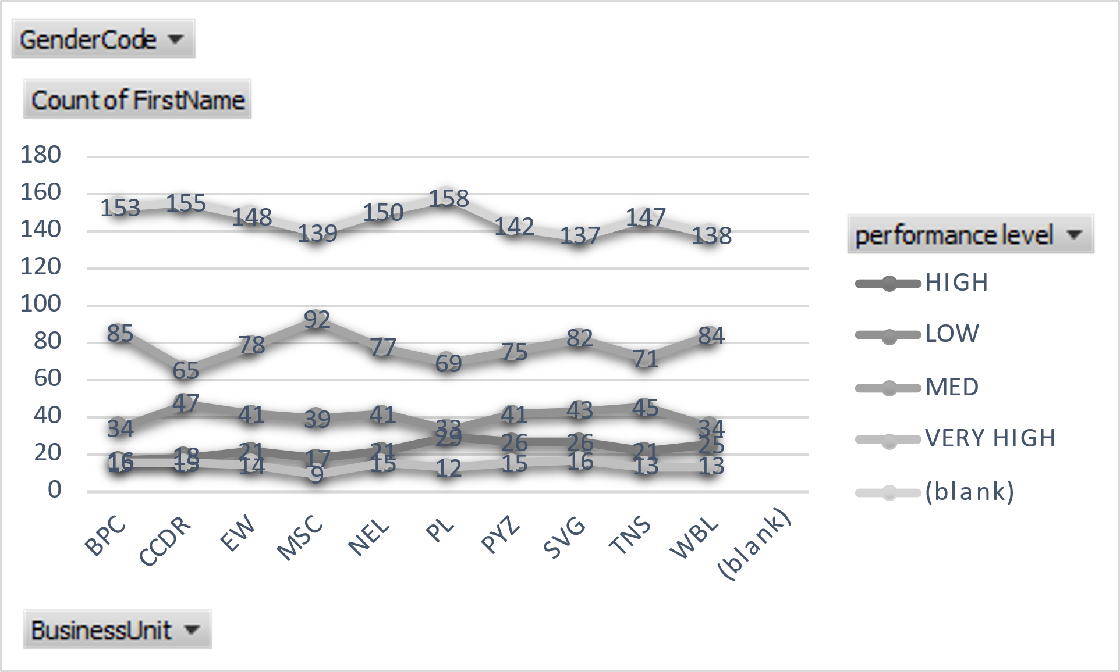
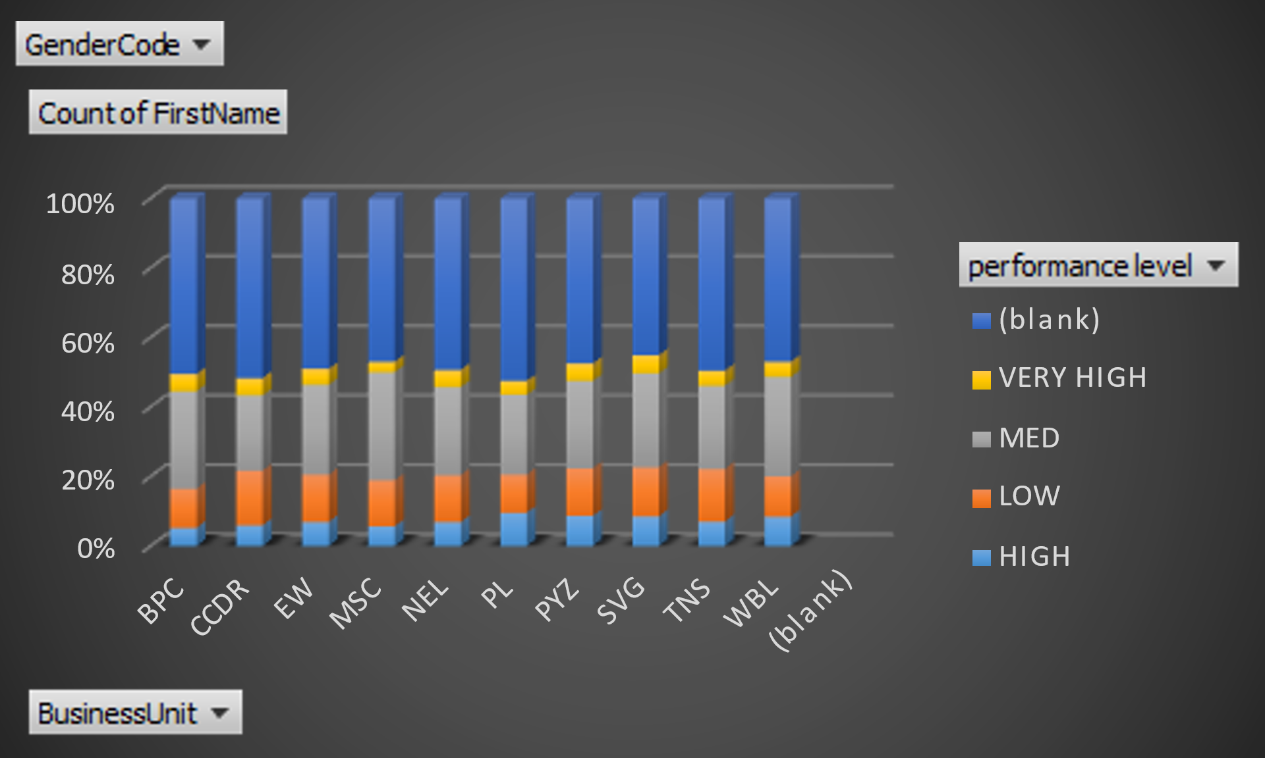
RESULTS

